Slide 1
AIHA National Update
Pittsburgh Local Section Event February, 2018

Slide 2
Today’s Agenda
Overview of AIHA National
National – Local Section Dynamics
Collaborations & Partnerships
Grassroots Awareness of Profession
Government Relations
AIH Foundation
The Future is Now!

Slide 3
AIHA Organization Structure
Notes:
Roughly 50% of AIHA National’s gross revenues come from the 3 LLCs. These monies are reinvested in serving the membership and professional communities, including Manitoba. Membership dues account for under $1.4 million out of our $16 million budget.

Slide 4
Strategic Priorities 2016-18 Current Focus Areas
Enable AIHA and its community of professionals support tool and technology development to meet needs of the profession.
Foster Community AIHA connects professionals who support the mission.
Influence AIHA and its members inform decisions through collaboration, communication, education and advocacy.
1. Drive AIHA’s content focus and dissemination
2. Customize benefits to maximize value to members
3. Pioneer a coalition to advance and IH science and practice
4. Partner to generate and disseminate content
Overarching outcome: Protect Worker Health while ensuring a sustainable stream of resources.
5. Provide diverse support to local sections
6. Align support for all stages of career development
Notes:
This is a snapshot of the AIHA National’s strategic plan. We have just formed a new task force that will be reviewing our mission and vision statement, updating as needed, and drafting a new plan that will take effect January 2019. We anticipate the new plan will NOT be a total re-work, but rather an evolution of the current version.

Slide 5
AIHA Local Sections & National
Notes:
There have been reported tensions between AIHA National and our local sections. We are taking steps to remedy this.

Slide 6
Local Sections Challenges
5. Provide diverse support to local sections
Most common challenges National hears from Local Sections:
Member acquisition and retention
Members willing to serve in leadership roles (LS officers)
Having programs and/or events to offer to LS members
Communication/awareness of what National or other local sections are doing
Monthly QuickTakes now distributed to all LS members*
Pricing and/or resources that smaller or struggling local sections can’t afford
* Assuming we have your Roster!

Slide 7
Premier Partners Program
5. Provide diverse support to local sections
Customized membership and/or ala-a-carte options of value-based services/benefits tailored to meet the specific needs of a local section:
Incentives to attract new leaders/officers of local sections
Affordable educational content and professional development opportunities
Branded recruitment, retention and outreach resources for local section membership
Exclusive cost-savings
Notes:
Introducing our new Premier Partners organizational membership program exclusively designed for Local Sections. Here, a Local Section can pick and choose what is of value to them. The benefits are based on research conducted across Local Sections and built around what is of greatest value/interest to you. It is NOT a one size fits all approach.

Slide 8
Ala-a-Carte
5. Provide diverse support to local sections
10% off Professional Membership (new member only)—valued at $215 per
10% off Young Professional Membership (new member only)—valued at $107 per
Complimentary Student Membership (new member only)—valued at $31 per
25% off Virtual Local Section Subscription—valued at $750
10% off AIHA Archived Webinars—valued at $149–$295
Complimentary Synergist Webinar Series—valued at $800
15% off “IAMIH” Branded Banner Stand Signage—valued at $300
10% off “IAMIH” Branded Tablecloth—valued at $200
10% off one MarketPlace Publication Order
Complimentary Membership/Recruitment/Outreach Resources—valued at $500
Notes:
Local Sections can customize a package that meets the needs of their members. Each Local Section has the option to pick up to five (5) ala-a-carte items, each featuring exclusive cost savings.

Slide 9
Intangible Benefits
5. Provide diverse support to local sections
Co-marketing of Local Section membership through National
Local Sections with more to offer may result in new members, stronger retention
Stronger communication between LS and National
Supported by AIHA National Strategic Plan
Focus Area #2: Customize benefits to maximize value to members
Focus Area #5: Provide diverse support to Local Sections
For more information, contact Laurie Mutdosch at lmutdosch@aiha.org
Notes:
There are intangible benefits as well, and as you can see, the program reflects two elements of the AIHA’s strategic plan. For more info, contact Laurie.

Slide 10
Ahead in 2018
5. Provide diverse support to local sections
Virtual Section Concept
Q1: Facilitated core team in-person meeting at HQ
LSC Officer, LSRR, LS Liaison, LS President, Student LS Officer, AIHA National Board Member, Staff
Local Section Summit
Early Q3: Facilitated core team in-person meeting at NQ
Key discussion items including LS Concept Paper, 2017 AIHA National Survey findings, Premier Partners Program
Notes:
AIHA National is committed to exploring the merits of launching a new Virtual Section, designed to complement (not compete) with bricks and mortar Local Sections. We’ll be holding a facilitated meeting to discuss further in Q1. In addition, we’ll be holding a second meeting to discuss on a broader level how to improve relations between National and Local Sections. Look for this meeting in July 2018.

Slide 11
5. Provide diverse support to local sections
Introducing: A New Online Community Platform
Notes:
Launching Q1 2018, a community based platform for National members only. We will have a LS officer “room” and also a general LS member “room” (but accessible only by National members in good standing). For non-National members, we are looking at posting LS related information elsewhere. Banners shown will rotate.

Slide 12
Education and Certification

Slide 13
Earning CIH Maintenance Points
AIHA On Demand
Cost effective ($35 or less per session)
Earn 1–3 hours of credit (0.167 point per hour per ABIH)
Synergist Webinars
0.167 point per hour
Publications
Write and publish articles for the Synergist or JOEH
Volunteer
Join a volunteer technical committee!
Committee chair/Local Section President earns 1 point per year
Active committee members earn 0.5 point per year
Local Section officers/committee earn 0.5 point per year
Mentoring
ABIH requires a minimum of six (6) hours within a 12 month period
1 point per year per mentee; maximum 5 points per CM cycle
Notes:
A friendly reminder from ABIH on how to earn CIH maintenance points. NOTE that the ABIH is in the process of potentially making adjustments to this. We’ll know more in March.

Slide 14
Credentialing Organizations
Certified Industrial Hygienist (CIH)
Appropriate degrees and coursework
3, 3.5, or 4 years or more of experience
Successfully pass 2 out of 4 areas on the CIH Exam
On-going professional development
For more information, visit www.abih.org
Qualified Environmental Practitioner (QEP)
Appropriate degrees and coursework
7 years or more experience
EPI/General Science Exam plus a Specialty Exam in either 1. Air Quality, 2. Solid & Hazardous Waste, 3. Water Quality, or 4. Environmental Science, Management & Policy
On-going professional development
For more information, visit www.ipep.org
Environmental Professional In-Training (EPI) designation
Recent graduate or less than 7 years experience
General Science Exam
For more information, visit www.ipep.org
Notes:
You should know that IPEP has now merged with ABIH. Here are the current credentialing options. There has been some talk about the development of a new EHS generalist certification but further research is needed. In addition AIHA is looking at partnering with ABIH to develop a new Product Steward certification.

Slide 15
3. Pioneer a coalition to advance and IH science and practice
Content Priorities / CPAG
Occupational Exposure Banding
IH Business Case Development
Sensor Technologies
Big Data/Big Data Management
Changing Workforce/Workplace
Global IH/OH Standard of Care
Emergency Preparedness and Response
Notes:
We are supporting a macro strategy in which content is developed collaboratively with volunteer groups and driven by defined organizational priorities:
Effectively and efficiently convene, engage, and expand the AIHA member community
Increase the community’s knowledge
Pinpoint emerging trends and issues to develop useful scientific and technical content
Use our research data to help us identify member educational needs and respond accordingly. Data-driven approach rather than hunches.
Micro-volunteer and traditional volunteer opportunities
Store leadership development materials (member and non-member content)

Slide 16
1. Drive AIHA’s content focus and dissemination
It’s not just a conference, it is an EXPerience!
Saves time out of the office: Monday-Wednesday Technical Conference; PDCs offered Saturday, Sunday, and Thursday
New, proven-effective educational formats: Case studies, scientific research, and technical presentations done early mornings and late evenings; all sessions will be one hour in length and will break at the same time
Organized by similar topics: Sessions scheduled via tracks
Additional applied education: Wednesday Closing General Session introduced in 2017
Notes:
We are committed to hosting a conference that features cutting edge contact as well as more fundamental material for younger professionals. We’ve reconfigured the program to ensure you as an attendee earn at least 18 CIH hours (possibly more). AIHce 2018 will be held in Philadelphia, May 19-24. Looking ahead in 2019 we’ll be in Minneapolis, May 18-23

Slide 17
Collaborations & Partnerships

Slide 18
American Alliance for Innovation
Road to Zero Coalition
Developing World Outreach Initiative
Collaborative for Effective Prescription Opioid Policies
IEQ-GA
Total Worker Health Affiliate Organization
Notes:
This slide depicts some of the many agreements AIHA has with third party organizations and agencies. For example, we are particularly excited about our new MOU with ASSE – many local sections currently partner with ASSE chapters around the US. Internationally, we are expanding our presence in India and participated this past January in a brand new joint session focusing on the concept of Total Worker Health that was targeted at both occupational physicians and IH professionals.

Slide 19
4. Partner to generate and disseminate content
Saturday, Sept 22 – Wednesday, Sept 26
Notes:
IOHA 11th International Scientific Conference, hosted by AIHA at the Marriott Marquis DC Hotel. The theme is “IOHA 2018: Bringing Better Health to Workers Worldwide”
IOHA is scheduled for Saturday, September 22-Wednesday, September 26 (PDCs will be held Saturday, Sunday as well as Thursday, and the main technical program will be held Monday through Wednesday).
Two meetings will also be co-located at the Marriott Marquis
Future Leadership Institute – Friday, September 21-Sunday, September 23
Product Stewardship Conference – Wednesday, September 26 (afternoon only)-Saturday, September 29

Slide 20
3. Pioneer a coalition to advance and IH science and practice
NIOSH is interested in (1) finding partners who can provide access to workplaces for investigation in the following areas; (2) providing information about its research in these areas; and (3) identifying Apps that would help you in your work.
Cleaning and disinfecting chemicals among healthcare workers - Acute respiratory effects | Coal tar sealants during pavement sealing
Exposure to styrene among boat or wind blade manufacturers – respiratory health effects. | Respiratory and musculoskeletal exposures in shipyards
Advanced Manufacturing – robotics, 3D printing, other additive manufacturing | Occupational Exposures in Upstream Oil and Gas Exploration and Production
Silica Exposure – granite countertops | Evaluating the effect(s) of prolonged heat exposure on cognitive performance/ Underground or surface mines
Vape Shops | Design and implementation of a fatigue management system/ All mine types
Opioids – first responders, HCW, others | Understanding the prevalence, cost and functional outcomes of illnesses and chronic disease in mining/ All mine types
Healthcare Workers– Nurses/nursing assistants (job stress, lower extremity disorders, long work hours) | Beyond compliance. Improving monitoring of worker exposures in mining using a risk-based approach.
Contact Russ Hayward (rhayward@aiha.org) to indicate which project(s) you’d like to participate in.
Notes:
AIHA enjoys a close relationship with NIOSH. This slide depicts various active projects currently being studied by their respiratory health division. If you are interested in serving as a point of contact for any of these, contact Russ.

Slide 21
Grassroots Awareness

Slide 22
#IAMIH Leadership Challenge
Launched #IAmIH campaign at 2016 Fall Conference
Leadership challenge initiated at 2017 Leadership Workshop
Telling your story about how you became an IH and the impact you’ve had in your communities -- short documentary and captioned videos premiered at AIHce 2017
Notes:
AIHA is committed to helping to enhance the brand promise of the profession.

Slide 23
Communicating to Groups NOT Like Ourselves
Notes:
This slide depicts the many audiences we intend to communicate with over time. Each will require a slightly different pitch, a set of communication talking points. We plan to select two audiences this year, review/update collateral materials designed for each, and draft marketing plan with defined metrics of success. The bottom line is we need to get better at talking to people who are different than ourselves.

Slide 24
6. Align support for all stages of career development
To identify unique & differing needs of IH/OH professionals throughout their careers by aligning each phase with AIHA resources & volunteer opportunities, and access to allied organizational training:
Encourage and support pursuit of credentials including CIH
Encourage and foster engagement within AIHA.
Notes:
IH Professional Pathways provides resources for professional and career development to our members. The skills and experience needed at each level of the career are clearly defined so that members can plan their professional development to support their path to wherever they want to go.
Each stage of an IH professional’s career can be defined by knowledge in three areas: T (technical), M (management), and L (leadership). Knowledge areas for each stage provide an understanding of how industrial hygienists can progress on their career pathways.
AIHA is currently working on new services and products to each of these career stages including a new self-assessment tool, as well as defining a 5th stage “emeritus” for retirees and what their role is.
AIHA is beginning to align our resources and opportunities with each career level. Most obvious is the benefit of aligning education with the needs of different levels. Equally important is to align the volunteer opportunities within AIHA that provide the chance to build many leadership and management skills. Some of AIHA’s volunteer groups provide specific services that are helpful at different levels along the career path. These groups include Career & Employment Services, Student and Early Career Professionals, and the Mentoring Committee.

Slide 25
Each level of an IH professional's career can be described by the relevant knowledge and leadership and management skills.
Student/Intern Professional
Early Career Professional Senior Professional
Notes:
There are currently 4 phases of professionals represented in the IH Pro Pathways program. In addition, the IH Heroes program is specifically designed to appeal to secondary school kids. The case for becoming an IH professional is illustrated through engaging comic books.

Slide 26
Code Name: IH
The not-so-secret mission of a well hidden band of safety superheroes… and how you can join their crew.
Notes:
Here’s a snapshot of one of those comic books.

Slide 27
AIHA + NIOSH Partnership: Safety Matters
Objective: Equip young people with the skills and knowledge they need to participate in safe and healthy work environments throughout their working lives.
Notes:
NIOSH and AIHA recently joined forces to create Safety Matters, a program to raise awareness among young people about workplace safety and health and to provide an understanding of the skills they need to become active participants in creating safe and healthy work environments. Though geared mostly towards high school students to learn about safety in the workplace, the program has also raised awareness of the IH profession in general.
The program teaches students that ALL workers can be injured, become sick, or even be killed on the job; That work-related injuries and illnesses are predictable and can be prevented; How to identify hazards at work; How to prevent injury and illness

Slide 28
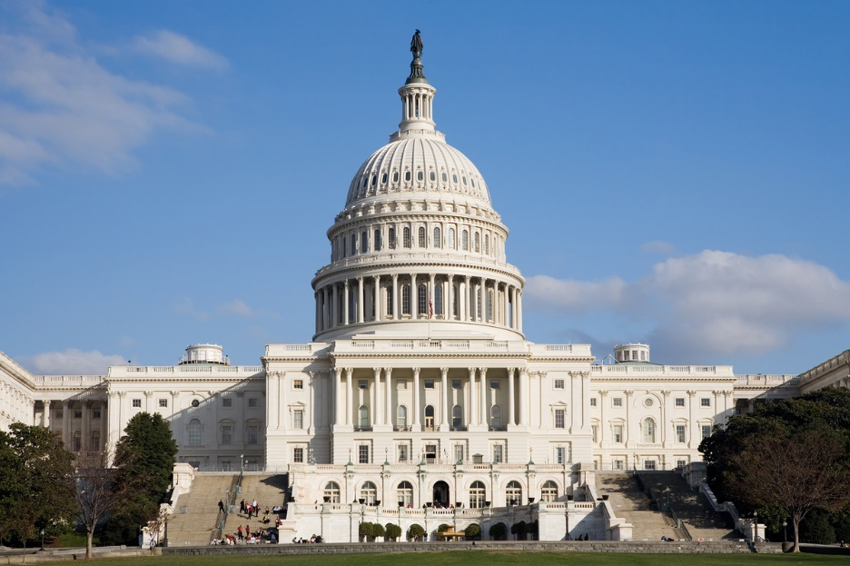
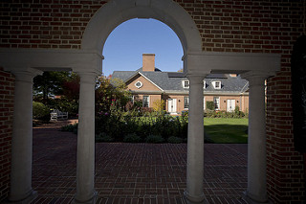
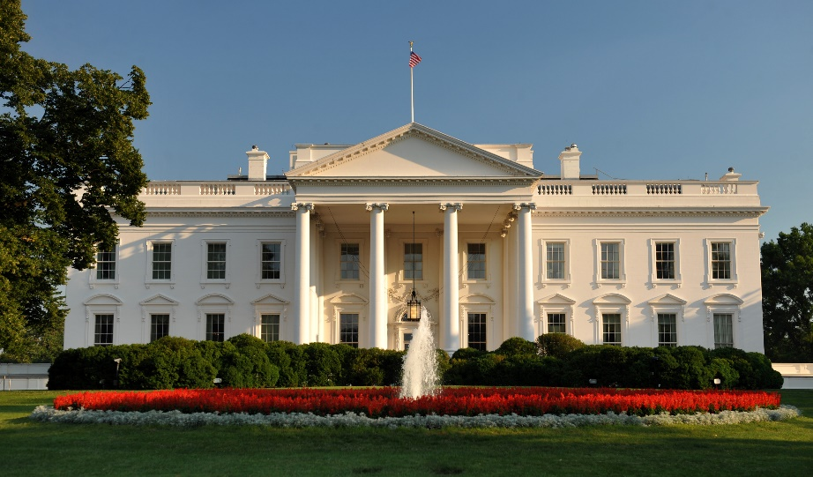
Government Relations

Slide 29
The Need for Transformative Change…
Each day approx. 150 people die from work-related injuries and diseases in the US.
Huge emotional toll.
Scary financial impacts. When factoring in non-fatal injuries, costs to businesses exceed $1 billion each week.
A tragedy for friends & family, communities -- these injuries, illnesses and deaths are preventable.

Slide 30
2018 Public Policy Priorities
Protecting first responders and others from occupational exposure to opioids and their synthetic analogues
Teen workplace safety education
Cannabis industry worker health and safety
Disaster preparedness and response
Protections for contingent workers

Slide 31
Taking Action
Opioids
Working w/the President’s Opioids Commission, whose final report now strongly emphasizes our concerns. Implementing recommendations
Held several mtgs w/State & Federal policymakers to expand awareness of this issue; partner to develop solutions
AIHceEXP 2018 features General Session panel entitled “Mitigating Opioid Exposure Risks to First Responders: ​What’s Been Done, What’s Left to Do & How You Can Help”
Joined a broader opioids coalition AND created an AIHA Opioids Working Group to assess needs, develop technical and policy recommendations
Developed model legislative language

Slide 32
Taking Action
Teen workplace safety education
Texas State legislation enacted into law last year; now being implemented.
Updated model letter to State & Federal legislators promoting intro of legislation supporting Safety Matters and the Youth@Work-Talking Safety curriculum.
Several mtings held w/State & Federal Legislators to promote awareness & seek introduction of model legislation.
Created a Teen Workplace Safety Task Force to promote the use of Safety Matters and the Youth@Work-Talking Safety curriculum into local, State and Federal statutes.
Creating a new coalition to focus attention on need to educate teens about workplace safety.

Slide 33
Taking Action
Cannabis industry worker health and safety
Created a new working group, which now has five subgroups, focused on various aspects of the industry (e.g., manufacturing, lab accred.)
Created a new “elevator pitch” letter, used to introduce prospective partners to AIHA’s involvement in this area
Attended State regulatory meetings in California, Colorado, etc.
Submitted recommendations on legislation & regs in California, Maine, Pennsylvania (lab accred.)
Connecting w/Canada, which is in the process of legalization
Breakfast presentation given at Fall 2017 conference
Two educational sessions (part 1, part 2) will be held at AIHce EXP 2018

Slide 34
Taking Action
Disaster preparedness and response
Working w/Congress on emergency funding
Hurricanes
Letters sent to Governors of Texas, Florida, Louisiana, Puerto containing recommendations, offers of assistance
Connected w/ Federal, State agencies & AIHA members to further understand needs, suggest recommendations. (FYI: The Vice Chair of AIHA’s GR Cmte spent ~4 months in PR conducting recovery work.)
Wildfires
Partnered w/California Industrial Hygiene Council (reps several AIHA Local Sections in CA) to send letter to CA Governor containing recommendations, offers of assistance

Slide 35
Taking Action
Protections for contingent workers
In AIHA’s comments to US DOL on their draft Strategic Plan for FY 2018-2022, we called for need to protect the ~3 million contingent workers in the US, who may be at greater risk of workplace injury, illness, death.
Currently exploring next steps for AIHA to make progress on this issue

Slide 36
Looking Ahead
Continued Federal regulatory upheaval. Senate confirmation of new OSHA head, Scott Mugno will be key (no date on this yet).
Silica rule survived challenge in US Court of Appeals for DC Circuit.
OSHA expected to propose changes to its final rule to Improve Tracking of Workplace Injuries and Illnesses
Beryllium: No recent news; litigation continues with more expected
Jurisdictional issues b/t EPA & OSHA concerning new TSCA & protections for workers; clarifying guidance expected

Slide 37
Looking Ahead
States and even local gov’ts will likely be more active than Feds/Congress.
States have been especially active lately on opioids, IEQ (mostly mold, Legionella), and cannabis.

Slide 38
It’s An Election Year!
More than 6,611 State and Federal seats up + more at the local level.
AIHA is encouraging its members to speak to their candidates and Parties about the importance of worker health & safety, and encourage them to incorporate our priorities into their speeches, etc.
AIHA is nonpartisan and doesn’t give $$ to candidates or endorse them.

Slide 39
Get Involved! ACTIONS (Govt Relations) Committee
Formal name: “AIHA Coalition of Technical Influencers On New Solutions (ACTIONS) Committee”.
Direct successor to AIHA’s Government Relations Beta Group.
The Beta Group was a trial balloon; when it amassed over 350 members, the need became clear for it to become a formal volunteer group = ACTIONS Committee.
Open to AIHA members. Non-members will be consulted as-needed to pull-in their technical expertise.

Slide 40
ACTIONS Committee
Core Functions:
Implementing the current, and proposing new goals and activities under AIHA’s Public Policy Priorities. This is done in collaboration with AIHA’s other VGs.
Developing specific language for legislation and regulations at the Federal, State, and Local levels.
Organizing and mobilizing AIHA’s members for the purpose of achieving the Association’s objectives through government relations.
Advising AIHA’s Board of Directors on GR matters.

Slide 41
ACTIONS Committee
Interested in joining?
Sign up by emailing Mark Ames, AIHA’s Director of Government Relations, at mames@aiha.org.

Slide 43
AIHF Needs Your Support
Commit to setting up an Endowed Scholarship and/or,
Commit to set-up a one-time or annual pass-through local section scholarship to be awarded for a particular year
Encourage presenters to donate PDC honorariums
Consider being a sponsor or provide an in-kind donation for 2018 Fun Run
Get recognition from your peers and colleagues as an AIHF donor via the website and on the Wall of Giving, which is prominently displayed at AIHce
Meet the scholarship recipient at the AIHF Donor Relations Reception at AIHce (invitational only)
**Contributions to AIHF are tax-deductible, as provided by law
Notes:
The OEHS profession needs a pipeline of highly trained and skilled professionals. To make sure this critical need is being met, the American Industrial Hygiene Foundation (AIHF) needs your help. The AIHF Mission is to “advance the profession by awarding scholarships for funding education and professional development in industrial hygiene and related disciplines”
Here are all of the great opportunities your local section can support the Foundation
If possible, set-up an Endowed Scholarship: minimum of $25k of funds need to be collected within a five year timeframe. And if you can’t make that level of commitment, set-up a one-time local section scholarship that will be awarded for a particular year.

Slide 44
Current Local Section Scholarships
Endowed Local Section Scholarships
Chicago Local Section
Deep South Local Section
Florida Local Section Section
Philadelphia Local Section
Michigan Industrial Hygiene Society Merit
Previous Pass Through Local Section Scholarships
Carolinas Local Section
Delaware Local Section
Pittsburgh Local Section
New England Local Section
Northern California Local Section
Ohio Valley Local Section
Notes:
Endowed scholarships are a minimum $25,000, which must be raised within a five year period; scholarships are awarded from the interest earned and never the endowed funds. A pass through is a minimum $1,000 scholarship and the funds are awarded for the particular scholarship year.

Slide 45
Future Leaders Institute Washington, DC (Sept 21 – 23, 2018)
Designed for young professionals with fewer than 15 years of work experience (members + non-members)
Applications are due March 9, 2018
Stephen C. Davis Future Leaders Institute Memorial Grant. Will provide travel funds to four international attendees.

Slide 46
Not an AIHA National Member?

Slide 47
For National Members Only
Additional Benefits
Immense networking opportunities with a national and international scope.
Opportunity to engage as a member of technical committees representing the various rubrics of the profession.
Opportunity to stay relevant on IH profession and OESH issues on a global scale.
Women in IH Forum
Discounted prices at AIHA sponsored conferences, seminars/webinars/workshops and on publications; access to members only resources.
Notes:
Services available to AIHA National members only

Slide 48
Additional Benefits
For National Members Only
Journal of Occupational and Environmental Hygiene (JOEH)
Professional Liability Insurance
Access to / your listing in online…
Member Directory
Leadership Directory (Volunteer Groups & Local Sections)
Consultants Listing (member-only offering)
CareerAdvantage Job Board, Counseling, and Tools
Leadership Training
Awards and Honors
Notes:
Services available to AIHA National members only

Slide 49
For National Members Only
Please email mentor@aiha.org if you’re interested in becoming a mentor or finding a mentor.
Notes:
AIHA offers a mentoring program. The program was developed to provide student members and early to mid-career professionals with mentors to assist them in their career development and to provide them with professional guidance. Matches primarily based upon geographic location followed by professional interests and personal interests/hobbies. We encourage participants to meet at least once a month either virtually, f2f, or via phone and that you maintain your relationship for one year.

Slide 50
AIHA must evolve…
Engage Student Local Sections more effectively
Recruit young IH professionals NOT currently members (not easy!)
Explore technical education and community needs of:
IH Technicians/Practitioners
EHS Generalists (< 15 years experience)
Continue to explore how VGs can partner collaboratively with Allied Organizations
And, and, and…
Notes:
We have many challenges ahead of us to remain a sustainable and thriving organization. Here are just a few that are on AIHA CEO’s radar.

Slide 51
Proposed Bylaw Amendments
Simplification of AIHA Member Classes:
Expanding FULL class / eliminating AFFILIATE and ASSOCIATE classes (same benefits for all)
Expanding scope of INTL class (full e-benefits for those outside USA or Canada)
Limiting scope of STUDENT class to full-time status (undergrad and grad)
Removing reference to Board service (enabling greater flexibility in who can potentially serve in future)
Notes:
We have many challenges ahead of us to remain a sustainable and thriving organization. Here are just a few that are on AIHA CEO’s radar.

Slide 52
Proposed Bylaw Amendments
Modification of AIHA Officer nomination process:
At-Large Directors: process remains UNCHANGED (contested race for open seats). Retain provision of write-in candidate option
Officers: change to 1 selected individual per position (eliminate contested race)
Greater transparency in composition of and process managed by Nominating Committee
Notes:
We have many challenges ahead of us to remain a sustainable and thriving organization. Here are just a few that are on AIHA CEO’s radar.

Slide 53
Proposed Bylaw Amendments
FAQ document being developed to address concerns
Communications plan to be deployed over next several months
Other minor amendments include elimination of ACADEMY, change in chief staff officer from Executive Director to CEO, congruency with latest Illinois non-profit state law*
Anticipate early summer ballot to general membership *AIHA is IL non-profit
Notes:
We have many challenges ahead of us to remain a sustainable and thriving organization. Here are just a few that are on AIHA CEO’s radar.

Slide 54
Connect Now!
Like us for exclusive AIHA information, updates, and offers
Follow us for important industry news and happenings
Join the discussion with other like-minded professionals
Get the latest scoop on news and more
Gain insights from thought leaders, view popular uploads, or catch an INGITE session
Get more information at www.aiha.org

Slide 55
THANK YOU FOR LISTENING. FOR MORE INFORMATION, CONTACT: Larry Sloan, CEO Direct: (703) 846-0760 lsloan@aiha.org

